Slide 1
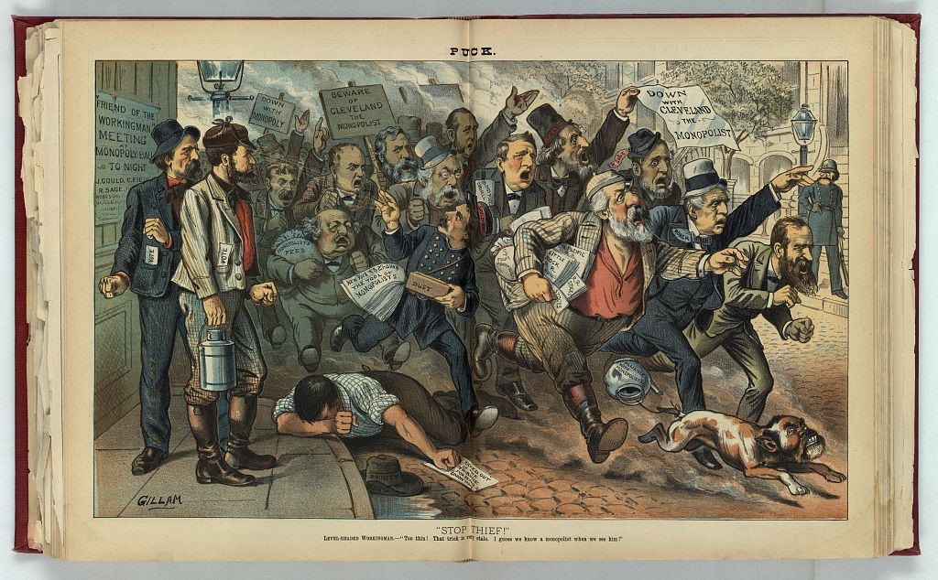
Visual Folklore
Description Example

Slide 2
Visual Folklore
Description Example
“Stop Thief!” by Bernard Gillam, published by Keppler & Schwarzmann, August 6,1884.
This image is in the Library of Congress.

Slide 3
Visual Folklore
Description Example
“Illustration, reminiscent of Thomas Nast's cartoon of the same title published in Harper's Weekly, October 7, 1871. [It] shows a group of monopolists and Blaine supporters scattering on the street in response to the cry ‘Stop thief!’
Joseph Keifer carries a sign that states ‘Beware of Cleveland the Monopolist’ and Cyrus Field waves a sheet that states ‘Down with Cleveland the Monopolist.’

Slide 4
Visual Folklore
Description Example
“Among the pursuers and those being pursued are William W. Phelps, Benjamin F. Butler carrying a bag of ‘Monopolist Fees,’ Robert Ingersoll, Keifer, George M. Robeson, Whitelaw Reid throwing ‘dust’ in the eyes of workingmen, Alonzo Cornell, Field, James G. Blaine carrying a bag of ‘$ from Monopolists’ and ‘R.R. Stocks,’ Russell Sage, John Roach, and Jay Gould, as well as a dog with the face of John Kelly(?), and with a teapot labeled ‘Alliance with Monopolists’ tied to its tail.

Slide 5
Visual Folklore
Description Example
“…all are determined to look like pursuers, instead of the object of the pursuit. Carl Schurz, dressed as a policeman, is standing on the sidewalk at far right. Two laborers are standing on the left, next to a sign that announces ‘Friend of the Workingman Meeting at Monopoly Hall To Night - J. Gould, C. Field, R. Sage, Robeson.’”

Slide 6
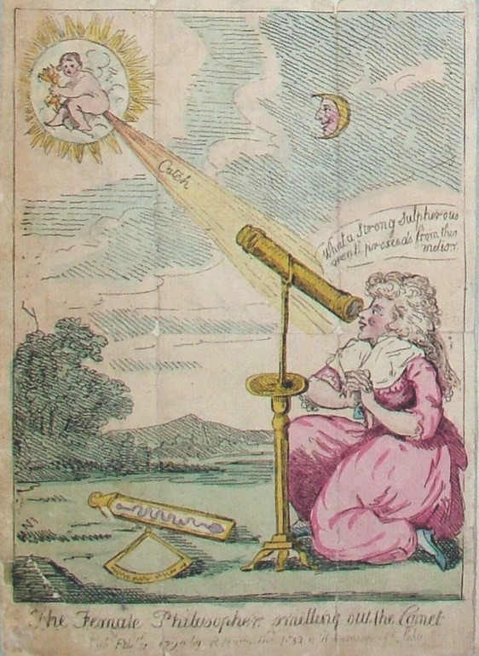
Visual Folklore
Description Example

Slide 7
This cartoon is taken from page 16 of the Hale Scrapbook 1746-1830. As is noted on their website: “The massive Hale scrapbook contains rare British cartoons, engravings, letters, and clippings dating from approximately 1746 to 1830. The original creator of the scrapbook is unknown, but it was probably made to document the history of the time period and to provide a source of entertainment.”
Visual Folklore
Description Example

Slide 8
Visual Folklore
Description Example
“[The cartoon] makes fun of Caroline Herschel, the first woman to be paid for her work in the sciences. Born in 1750, she became interested in astronomy while assisting her brother, William, who discovered the planet Uranus and was George III’s court astronomer. Caroline independently discovered eight comets, including two in 1790, the year this cartoon was published.”

Slide 9
Visual Folklore
Description Example
“…The cartoonist ridicules her, perhaps for stepping outside the bounds of the accepted domain of women at the time. In 1828, Caroline Herschel became the first woman to be awarded the Gold Medal of the Royal Astronomical Society. She remained the only woman to receive this prestigious award until 1996.”

